Slide 1
Generics

Slide 2
What is it?
Generics enable you to detect errors at compile time rather than at runtime.
With this capability, you can define a class, interfance or a method with generic types that the compiler can replace with concrete types.
For example, Java defines a generic ArrayList class for storing the elements of a generic type.
The key benefit of generics is to enable errors to be detected at compile time rather than at runtime.
If you attempt to use an incompatible object, the compiler will detect that error.

Slide 3
Motivations and Benefits
The motivation for using Java generics is to detect errors at compile time.
Here, <T> represents a formal generic type, which can be replaced later with an actual concrete type.
Replacing a generic type is called a generic instantiation.
By convention, a single capital letter such as E or T is used to denote a formal generic type.

Slide 4
Defining Generic class
A generic type can be defined for a class or interface. A concrete type must be specified when using the class to create an object or using the class or interface to declare a reference variable.
DemoGenericStack.java

Slide 5
Generic methods
A generic type can be defined for a static method.
GenericMethodDemo.java

Slide 6
Bounded Generic type
A generic type can be specified as a subtype of another type. Such a generic type is called bounded.
There may be times when you want to restrict the types that can be used as type arguments in a parameterized type.
For example, a method that operates on numbers might only want to accept instances of Number or its subclasses.
BoundedTypeDemo.java

Slide 7
Raw types and backward compatibility
A generic class or interface used without specifying a concrete type, called a raw type, enables backward compatibility with earlier versions of Java.
GenericStack stack = new GenericStack(); // raw type
This is roughly equivalent to
GenericStack<Object> stack = new GenericStack<Object>();

Slide 8
Wildcard generic type
You can use unbounded wildcards, bounded wildcards, or lower-bound wildcards to specify a range for a generic type.
What are wildcard generic types and why are they needed?
WildCardNeedDemo.java – bounded wildcard
It has a compile error in line 8 because intStack is not an instance of GenericStack<Number>. Thus, you cannot invoke max(intStack).
The fact is that Integer is a subtype of Number, but GenericStack<Integer> is not a subtype of GenericStack<Number>.

Slide 9
Unbounded wildcard ? (<? extends Object)
<?> is a wildcard that represents any object type.
It is equivalent to <? extends Object>. What happens if you replace GenericStack<?> with GenericStack<Object>?
It would be wrong to invoke print(intStack), because intStack is not an instance of GenericStack<Object>.
Note that GenericStack<Integer> is not a subtype of GenericStack<Object>, even though Integer is a subtype of Object.
AnyWildCardDemo.java

Slide 10
Lower bounded wildcard
The third form, ? super T, called a lower-bound wildcard, denotes T or a supertype of T.
SuperWildCardDemo.java

Slide 11
Program
Implement the following generic method for linear search.
public static <E extends Comparable<E>> int linearSearch(E[] list, E key)
LinearSearch.java

Slide 12
Generic class with two type parameter
You can declare more than one type parameter in a generic type.
To specify two or more type parameters, simply use a comma-separated list.
TwoGen.java

Slide 13
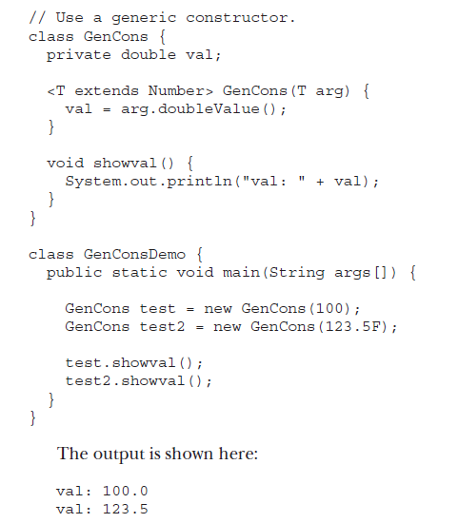
Cont.
Generic Types differ based on their type arguments. - Gen<T> class
Gen<Integer> g1 = new Gen<Integer>();
Gen<String> g2 = new Gen<String>();
g1 = g2 //error
Constructor can be generic even if its class is not.

Slide 14
Generic Interface
In addition to generic classes and methods, you can also have generic interfaces.
Generic interfaces are specified just like generic classes.
MinMax.java

Slide 15
Generic class hierarchy
Generic classes can be part of a class hierarchy in just the same way as a non-generic class.
Thus, a generic class can act as a superclass or be a subclass.
The key difference between generic and non-generic hierarchies is that in a generic hierarchy, any type arguments needed by a generic superclass must be passed up the hierarchy by all subclasses.
This is similar to the way that constructor arguments must be passed up a hierarchy.
GenHierarchy.java

Slide 16
Method overriding in generic class
A method in a generic class can be overridden just like any other method.
Gen2MethodOver.java

Slide 17
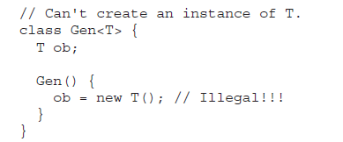
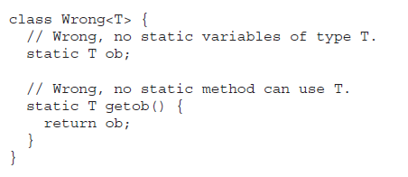


Some generic restrictions
Type Parameters Can’t Be Instantiated.
Restrictions on Static Members
Generic Array Restrictions
A generic class cannot extend Throwable. This means that you cannot create generic exception classes.

Slide 18
List, Stack, Queue and Priority Queue

Slide 19
Collection Framework
Choosing the best data structures and algorithms for a particular task is one of the keys to developing high-performance software.
In object-oriented thinking, a data structure, also known as a container or container object, is an object that stores other objects, referred to as data or elements.
ArrayList class, which is a data structure to store elements in a list.
Java provides several more data structures that can be used to organize and manipulate data efficiently. These are commonly known as Java Collections Framework.

Slide 20
Cont.
The common features of these collections are defined in the interfaces, and implementations are provided in concrete classes.

Slide 22
Cont.
The Java Collections Framework supports two types of containers:
One for storing a collection of elements is simply called a collection.
The other, for storing key/value pairs, is called a map.
In this unit, our attention is on to the following collections:
Sets store a group of nonduplicate elements.
Lists store an ordered collection of elements.
Stacks store objects that are processed in a last-in, first-out fashion.
Queues store objects that are processed in a first-in, first-out fashion.
PriorityQueues store objects that are processed in the order of their priorities.

Slide 23
Iterator
Each collection is Iterable. You can obtain its Iterator object to traverse all the elements in the collection.
The Collection interface extends the Iterable interface.
The Iterable interface defines the iterator method, which returns an iterator.
The Iterator interface provides a uniform way for traversing elements in various types of collections.
TestIterator.java

Slide 24
Lists
The List interface extends the Collection interface and defines a collection for storing elements in a sequential order.
To create a list, use one of its two concrete classes: ArrayList or LinkedList
TestArrayAndLinkedList.java

Slide 25
Linkedlist Vs ArrayList
The critical difference between them pertains to internal implementation, which affects their performance.
ArrayList is efficient for retrieving elements and LinkedList is efficient for inserting and removing elements at the beginning of the list.
Both have the same performance for inserting and removing elements in the middle or at the end of the list.

Slide 26
Comparator Interface
Comparator can be used to compare the objects of a class that doesn’t implement Comparable.
You can define a comparator to compare the elements of different classes.
To do so, define a class that implements the java.util.Comparator<T> interface and overrides its compare method.
TestComparator.java

Slide 27
Static methods of Lists and Collections

Slide 28
Vector and Stack Class
Vector is a subclass of AbstractList, and Stack is a subclass of Vector in the Java API.
Vector is the same as ArrayList, except that it contains synchronized methods for accessing and modifying the vector.
Synchronized methods can prevent data corruption when a vector is accessed and modified by two or more threads concurrently

Slide 31
Queues and Priority Queues
A queue is a first-in, first-out data structure. Elements are appended to the end of the queue and are removed from the beginning of the queue.
In a priority queue, elements are assigned priorities. When accessing elements, the element with the highest priority is removed first.

